Slide 1

Python

Slide 2

What is Python…?

Slide 3

HISTORY
Guido Van Rossum invented Python in 1991.
He named it Python because he was highly inspired by a show “Monty Python’s Flying Circus ”.
Python was the successor of ABC Language
Guido van Rossum

Slide 4
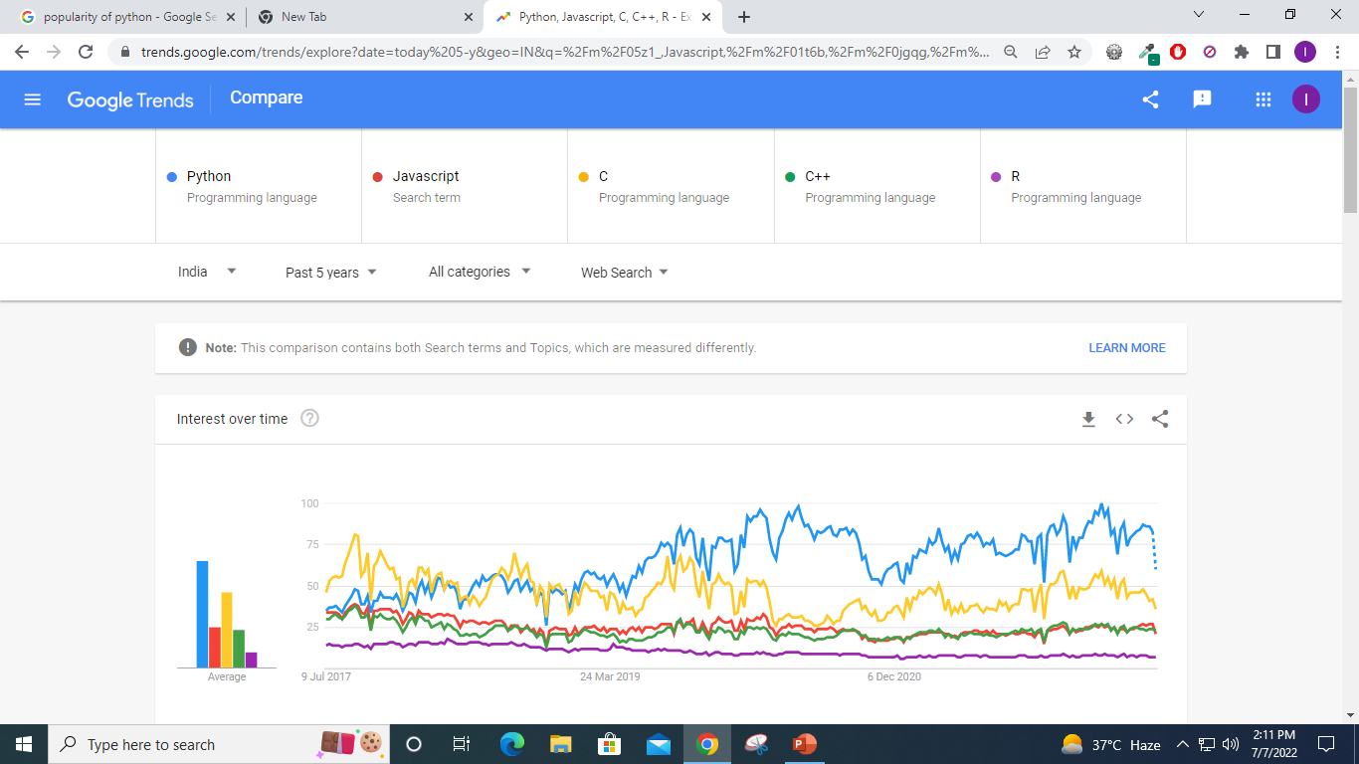
POPULARITY OF PYTHON

Slide 6
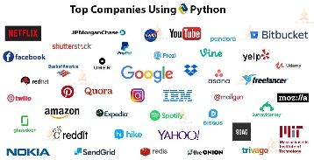
COMPANIES USING PYTHON

Slide 7
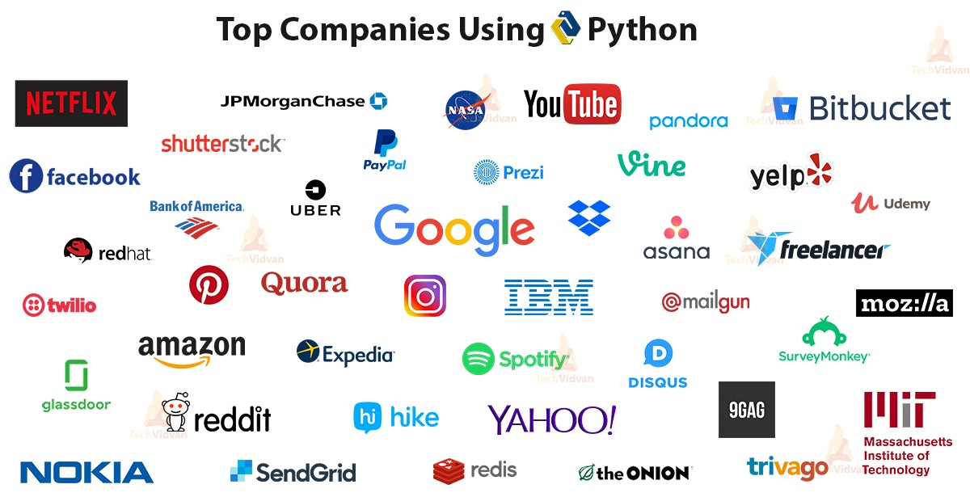
COMPANIES USING PYTHON

Slide 8
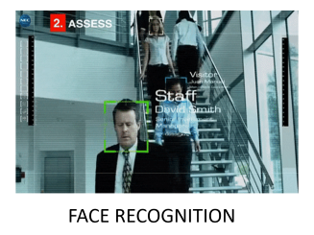
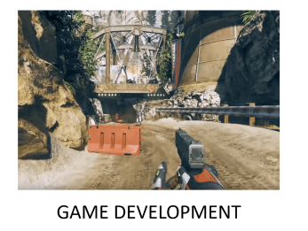
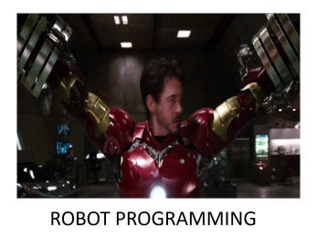



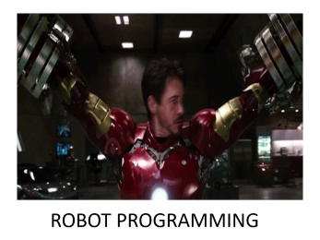
PYTHON APPLICATIONS

Slide 9

GAME DEVELOPMENT

Slide 10
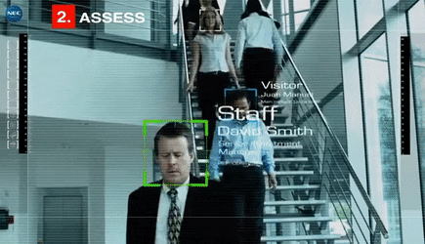
FACE RECOGNITION

Slide 11

WEB DEVELOPMENT

Slide 12

ROBOT PROGRAMMING

Slide 13
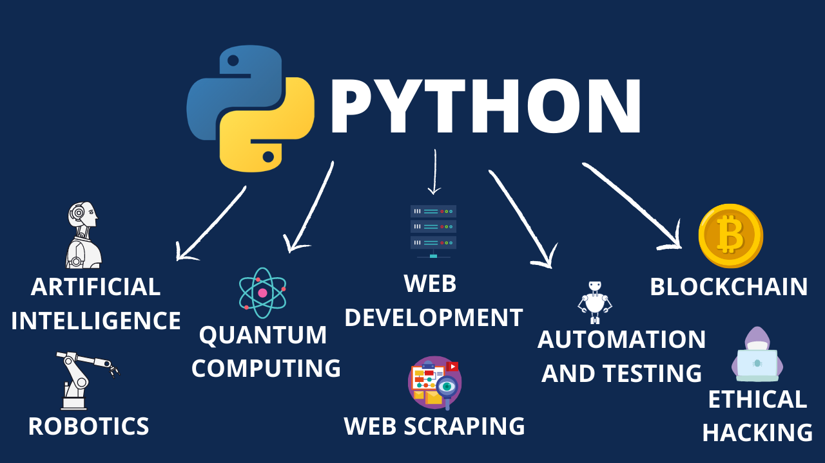

Slide 14
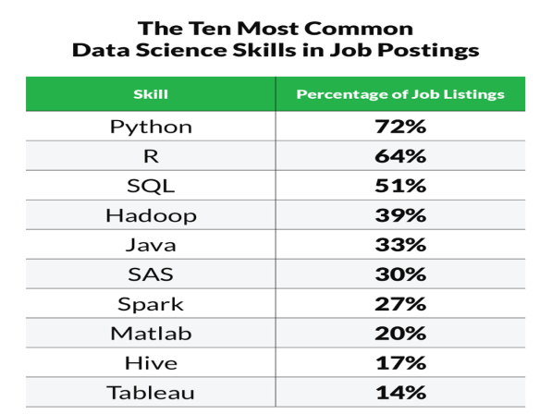

JOBS IN PYTHON

Slide 15
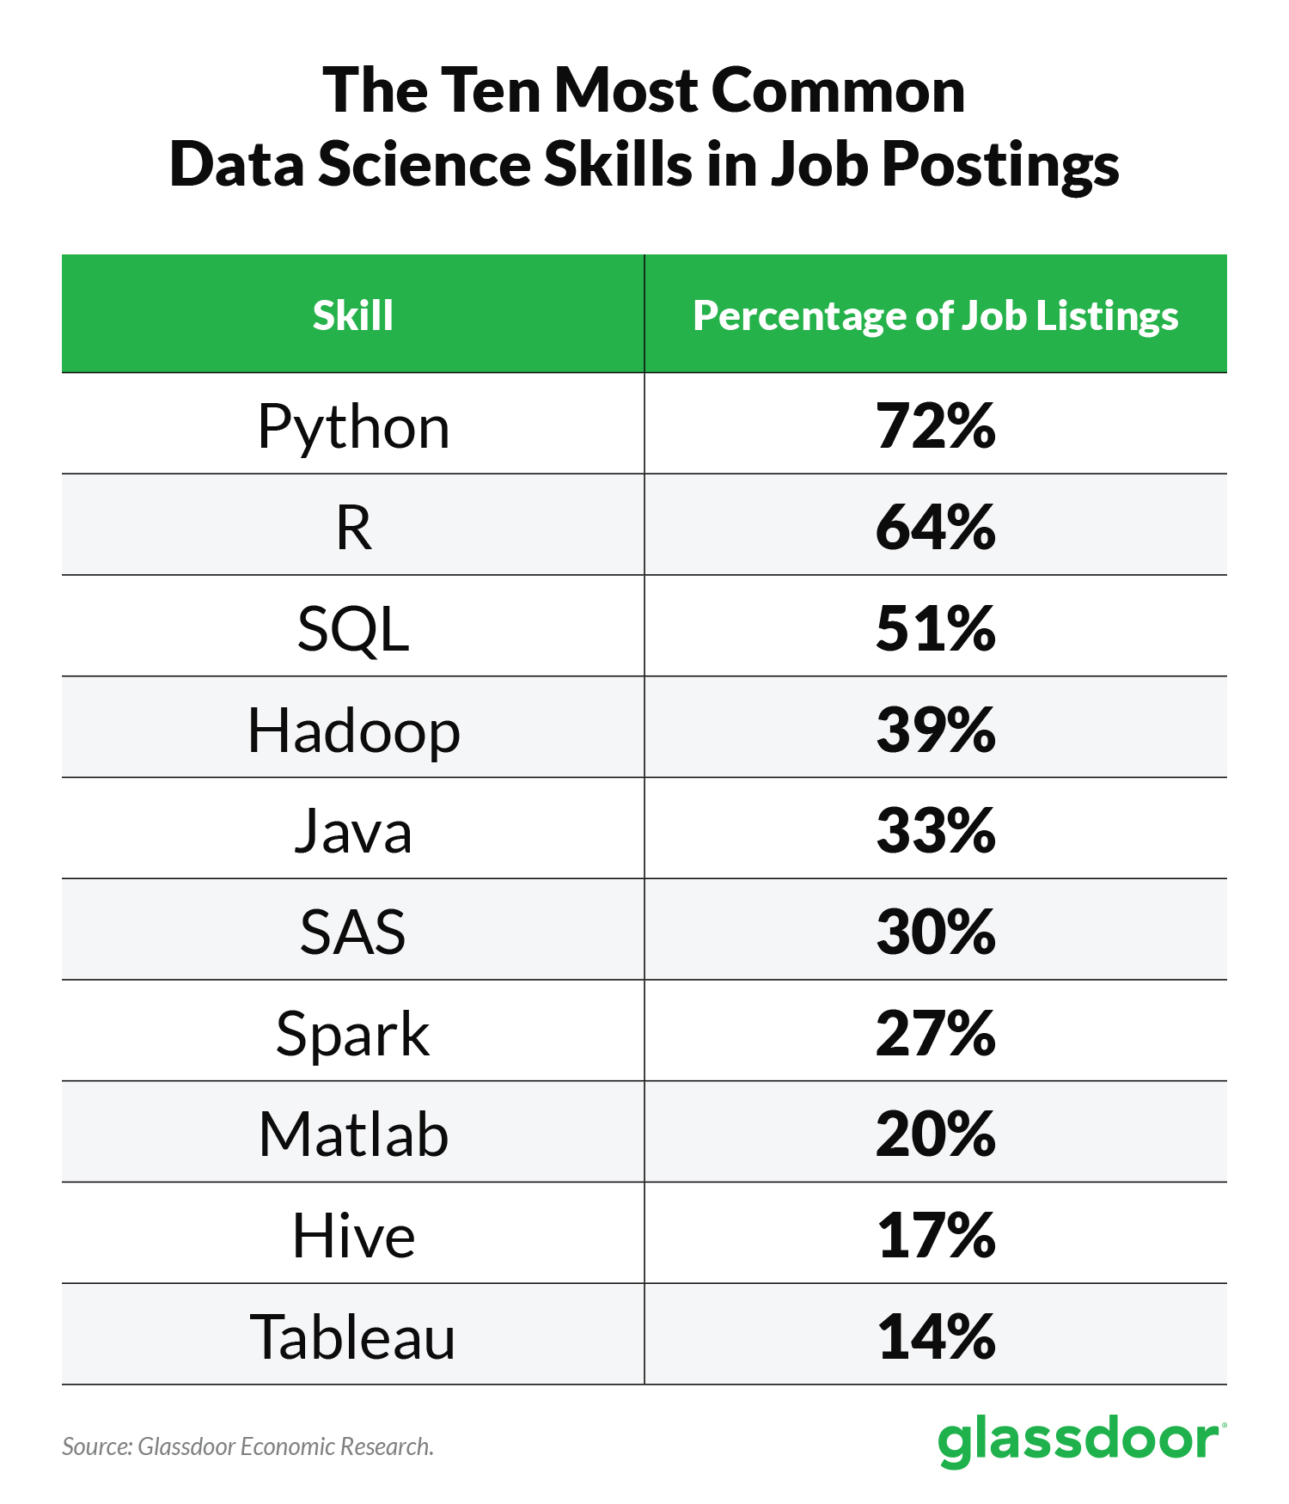

Slide 16
HOW TO DOWNLOAD PYTHON
Download Python :
https://www.python.org/downloads/
Note :
in Mac and Linux , You have Python2 Pre-Installed already. So, after Installing python3 , you need to first check where is the Python3 by Using (which python3) command , Then alter the path for python3.

Slide 17
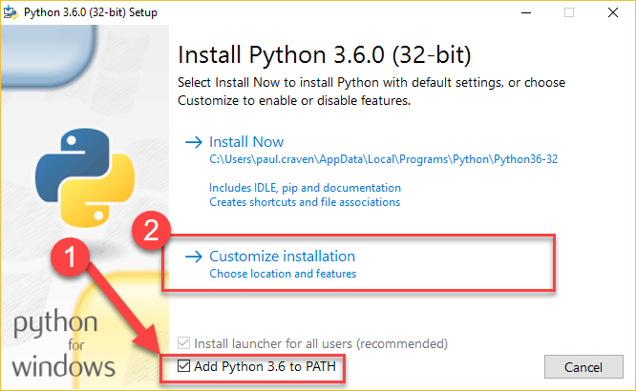
INSTALLATION IN WINDOWS
Note the following Steps and install it at correct destination folder As shown .

Slide 18
INSTALLATION IN WINDOWS

Slide 19
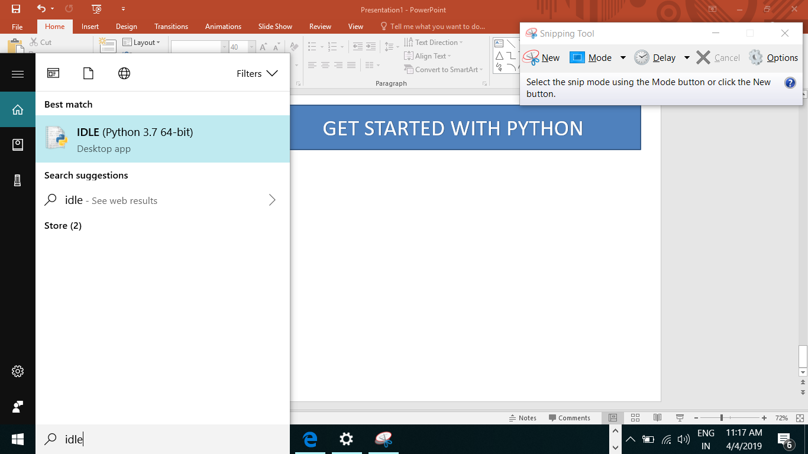
GET STARTED WITH PYTHON

Slide 20




PYTHON CODE EXECUTION
SOURCE
BYTE CODE
PVM

Slide 21

PYTHON PROGRAMMING’s ABC
What is Identifier?

Slide 22
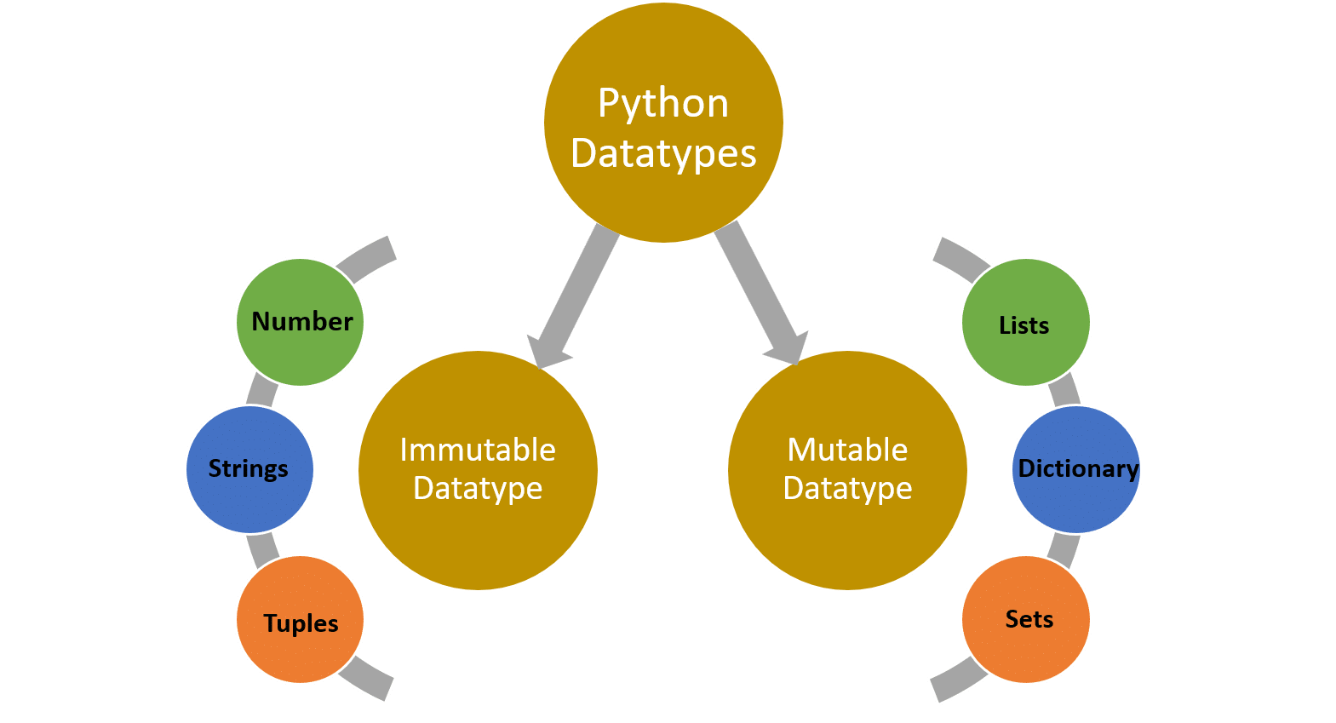
DATA TYPES

Slide 23
NUMERIC DATA TYPES
INT
COMPLEX
FLOAT

Slide 24

Arithmetic Operator
OPERATORS
Logical Operator
Assignment Operator
Comparison Operator
Identity Operator
Membership Operator

Slide 25
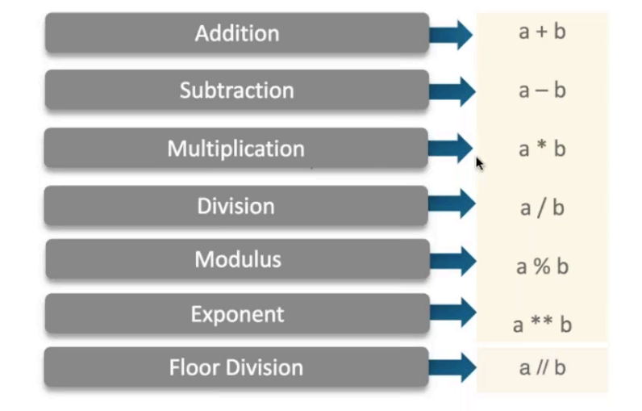
Arithmetic Operator

Slide 26
Logical Operator
AND
a and b
a or b
OR
NOT
not a

Slide 27
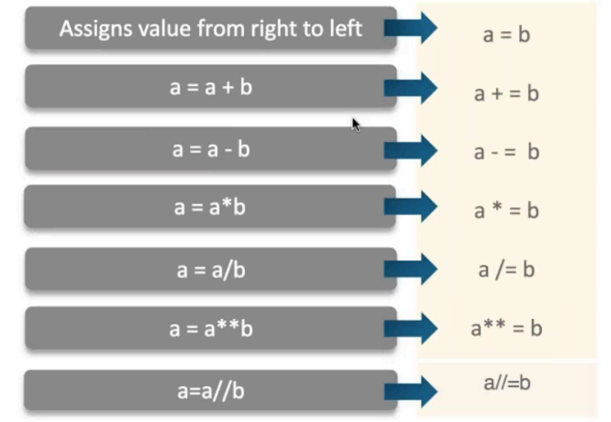
Assignment Operator

Slide 28
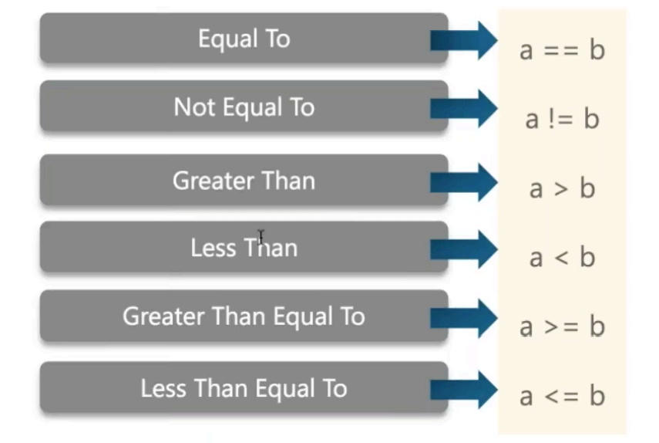
Comparison Operator

Slide 29
Identity Operator
IS
Returns true if both variable points to same object
IS NOT
Returns false if both variable doesn’t points to same object

Slide 30
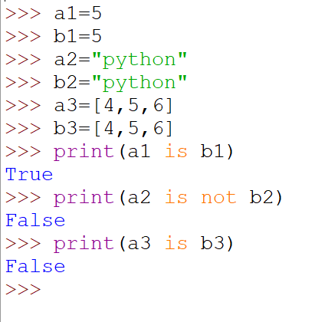

Slide 31
Membership Operator
IN
Returns true if it finds a variable in specified sequence
NOT IN
Returns false if it didn’t finds a variable in specified sequence

Slide 32
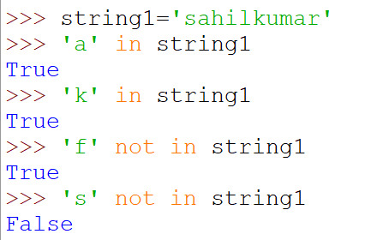

Slide 33

CONDITIONAL STATEMENT
if-else
The if-else statement is used to conditionally execute a statement or a block of statements based on required condition. Condition can be true or false, execute one thing when the condition is true, something else when the condition is false.

Slide 34
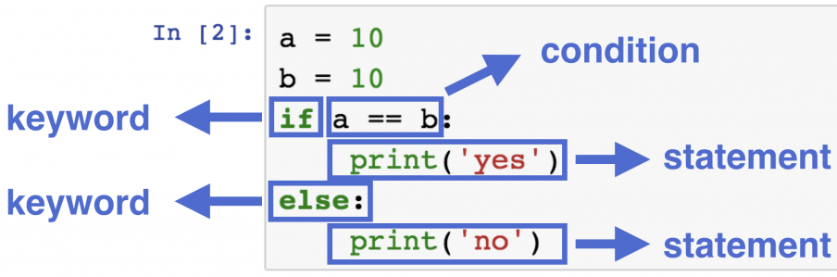

Slide 35
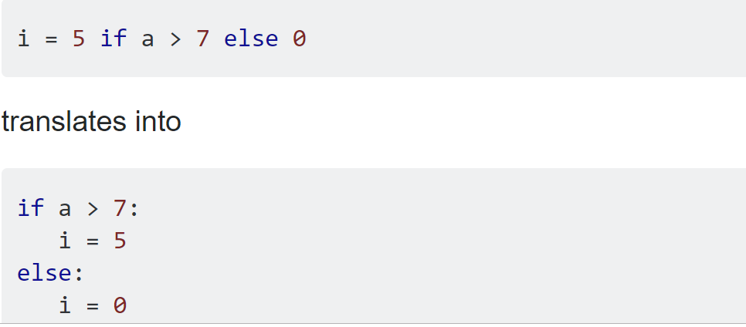
One Liner if-else Statement

Slide 36
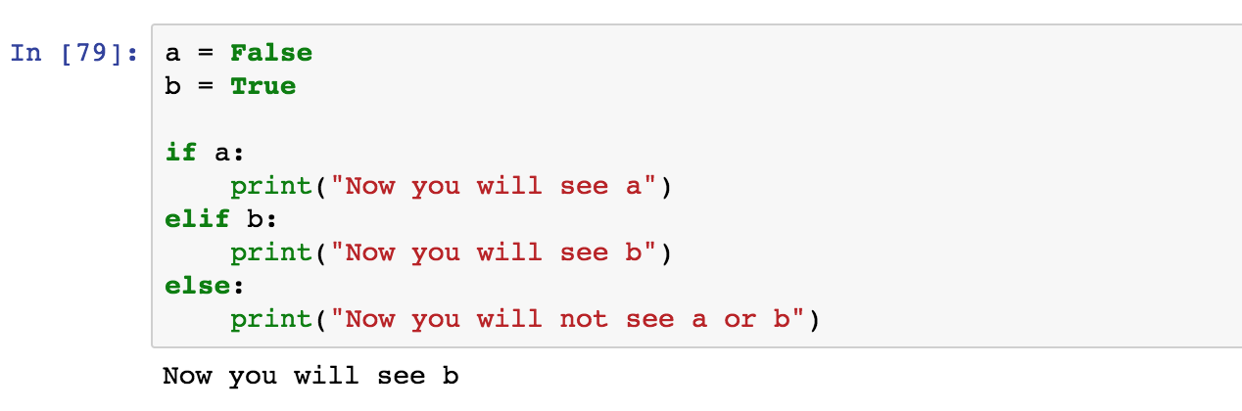
Note :
If you want to use multiple if-else conditions / nested if-else then, if-elif-else statement is used.
EXAMPLE :

Slide 37
LOOP

Slide 38

A loop is a sequence of instruction s that is continually repeated until a certain condition is reached.

Slide 39
Why Loops are used…?

Slide 40
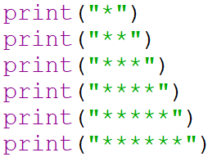
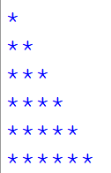
Syntax Comparison
Print * pattern triangle
OUTPUT

Slide 41
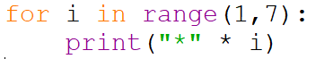
LOOPS Comes to rescue
OUTPUT

Slide 42

TYPES OF LOOPS
While Loop
For Loop

Slide 43
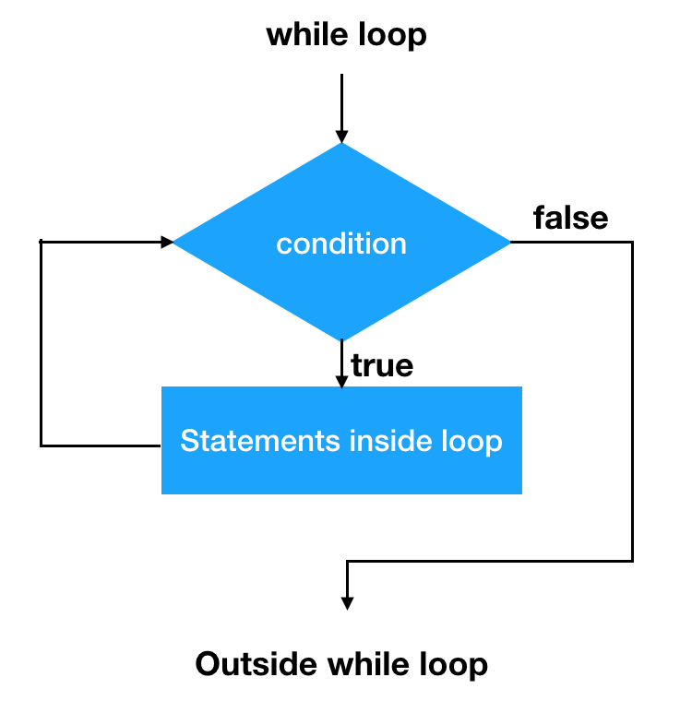

Slide 44
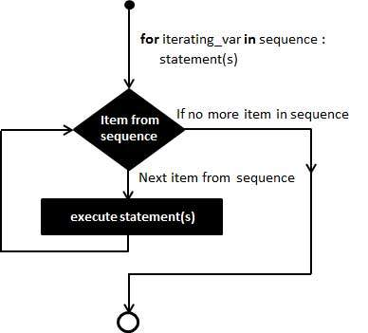

Slide 45
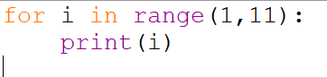
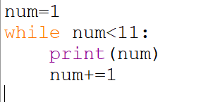
FOR LOOP V/s WHILE LOOP
Lets us take an example, Suppose we have to print the first ten numbers

Slide 46
KEYWORDS USED INSIDE LOOP
BREAK
PASS
CONTINUE

Slide 47

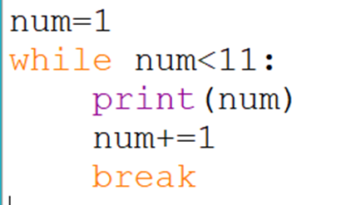
BREAK
Break Keyword is used to escape from while or for loop.
OUTPUT : 1

Slide 48
CONTINUE
Continue Keyword is used to skip current iteration and jump into next iteration in Loop.
1
2
3
4
5
6
7
8
9
10
OUTPUT
1
3
5
7
9
if number%2==0
Then continue
SET OF VALUES

Slide 49
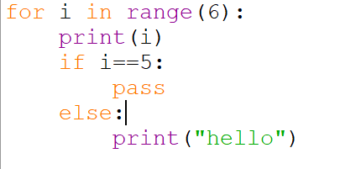
PASS
The pass statement is a null operation; nothing happens when it executes.

Slide 50
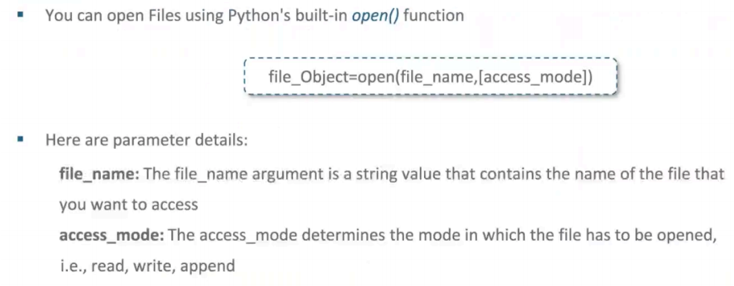
FILE OPERATIONS IN PYTHON
OPEN FUNCTION

Slide 51
OPEN FUNCTION – ACCESS MODES
Default mode which opens a file for read only.
r
r
rb
Opens a file for reading only in binary format.
rb
Opens a file for both reading and writing
rb+
Opens a file for both reading and writing
r+

Slide 52
Opens a file for both reading and writing format.
rb+
w
Opens a file for writing only.
wb
Opens a file for writing only in binary format.

Slide 53
Opens a file for appending.
a
ab+
Opens a file for appending in binary format.
a+
Opens a file for both appending and reading.

Slide 54
opens
ab+
w+
Opens a file for both reading and writing.
wb+
Opens a file for both reading and writing in binary format.

Slide 55
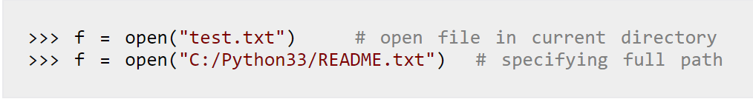
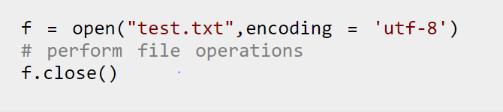
Open a file
Close a file

Slide 56
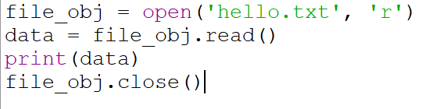
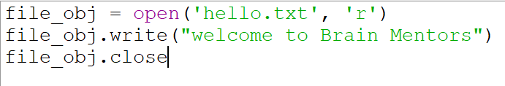
Read a file
Write a file

Slide 57
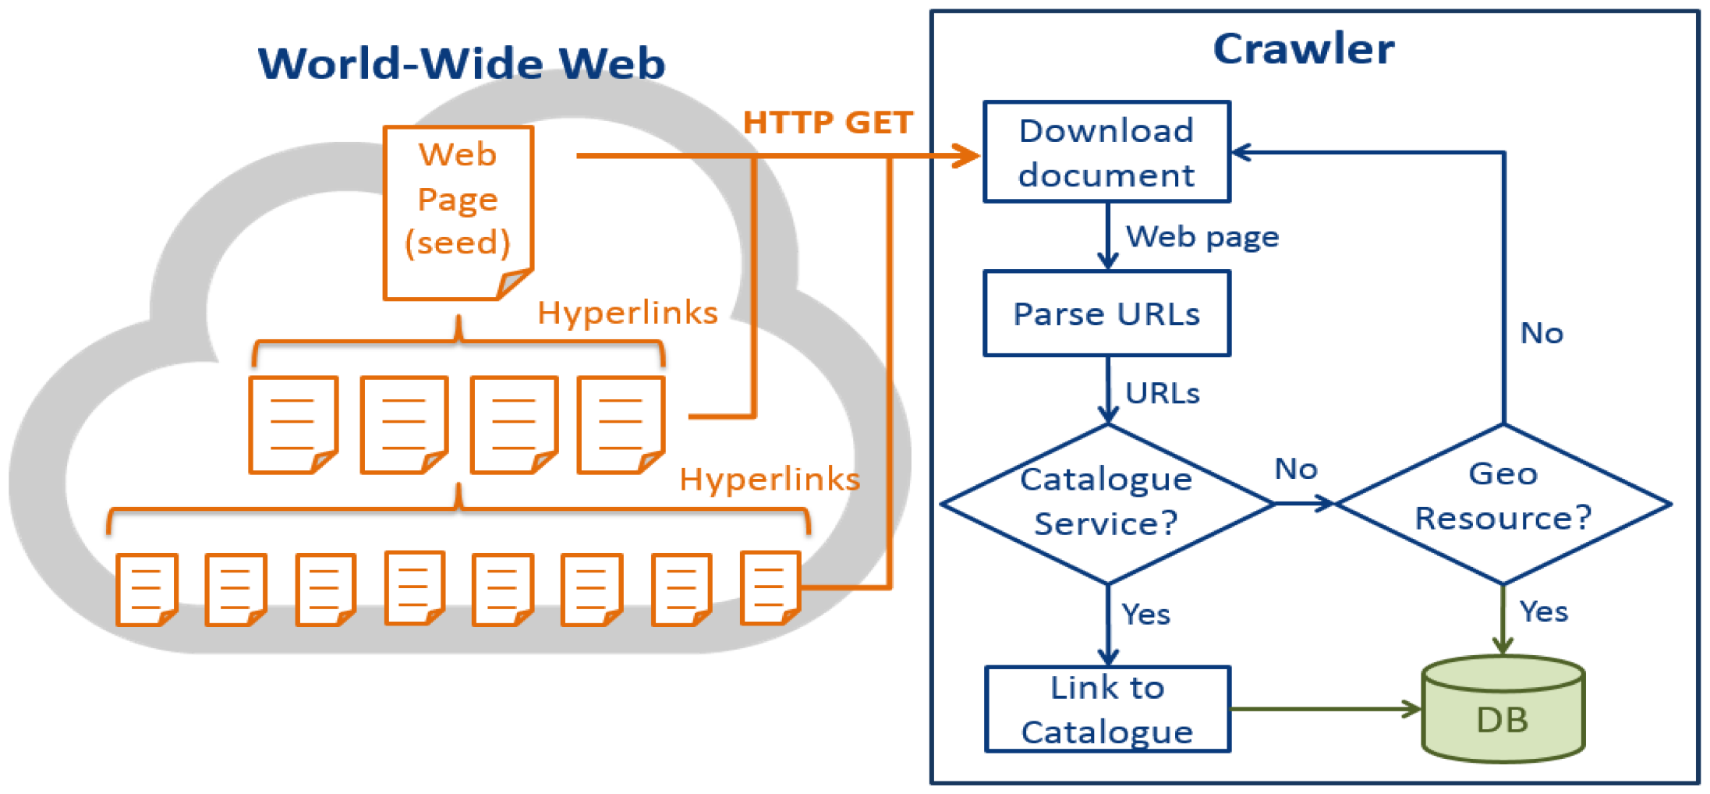
WEB CRAWLING
Web CRAWLER is a program or automated script which browses the World Wide Web in a methodical, automated manner and the process is known as WEB CRAWLING

Slide 58
Types of Sequence in Python
Lists
String
Dictionary
Numeric
Tuple
Set

Slide 59
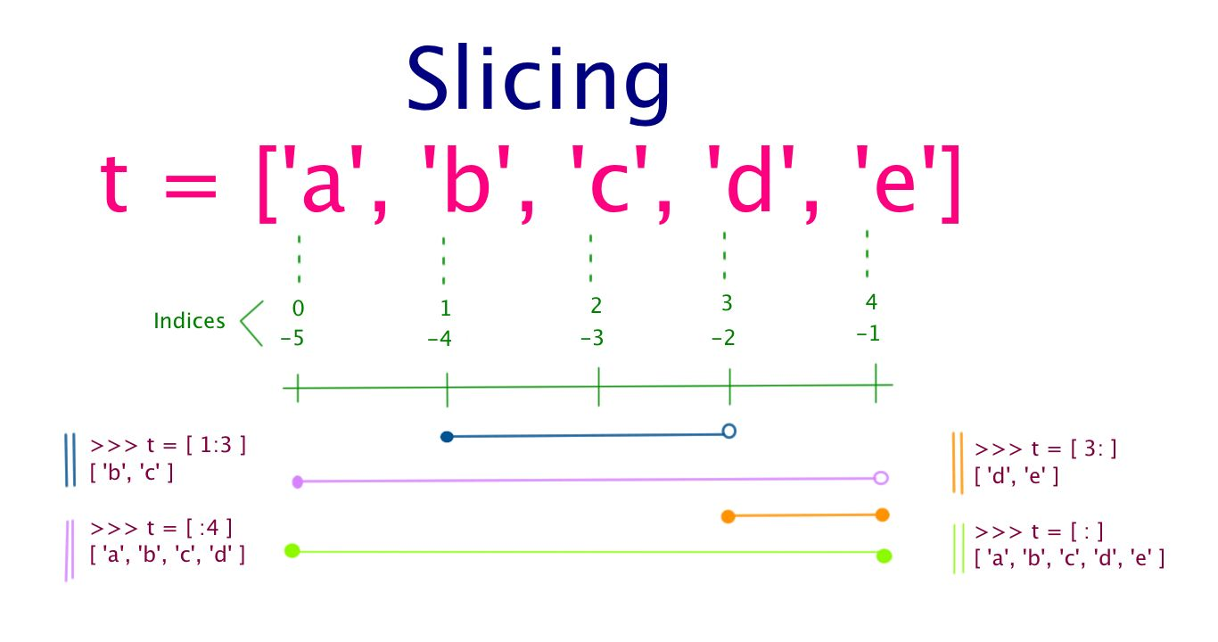
LIST

Slide 60
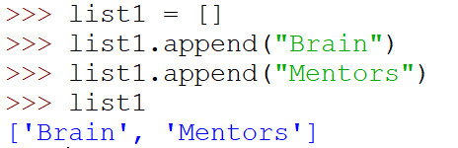
APPEND DATA IN LIST
Appending items to LIST

Slide 61
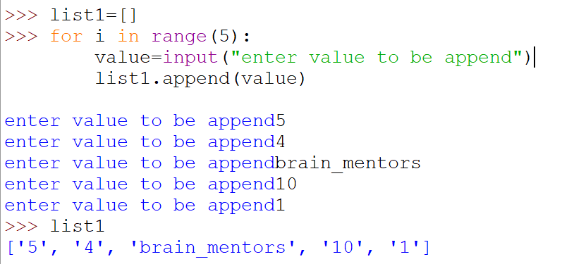
Note:- Only one element can be inserted into list at a time using append function.
Therefore, we have to use loop in order to append multiple values….

Slide 62
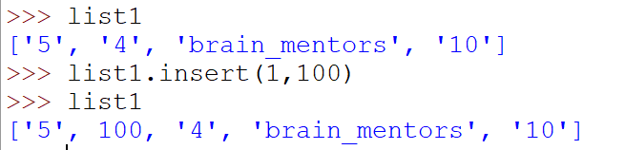
Append function append the value at the last of the list. If we have to insert a value in between list. Then the code will be as follows:

Slide 63
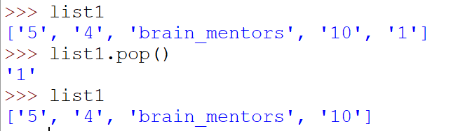
Deleting items from LIST

Slide 64
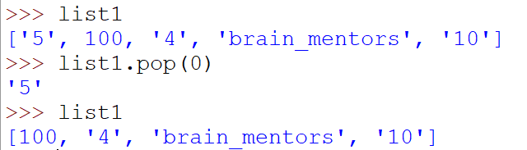
Pop function will delete the value from the last of the list. If we have to delete a value from between list. Then the code will be as follows:

Slide 65
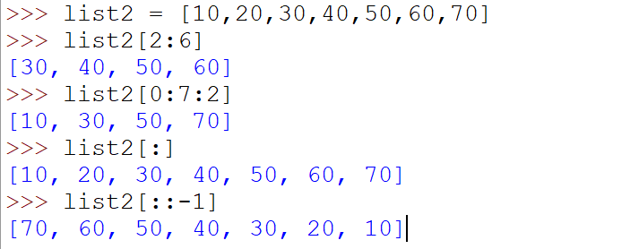
List Slicing
# here 2 is no of steps
# -1 to list from backside to get its reversed

Slide 66
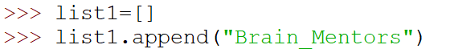
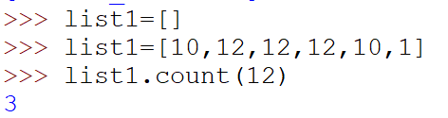
List Methods
append
Used to insert items into list .
Returns the count of no of items in a list.
count

Slide 67
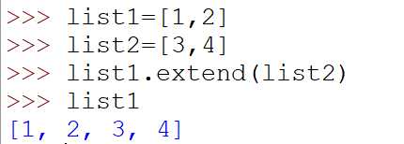
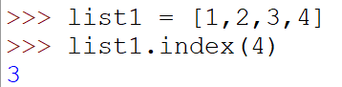
Add all elements to a list of another list.
extend
Returns index of the first matched item.
index

Slide 68
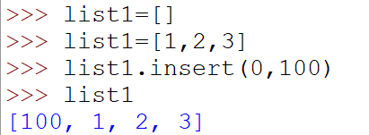
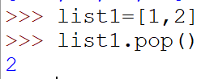
Insert an element at defined index.
insert
Removes and returns an element at the given index.
pop

Slide 69


Returns a shallow copy of list.
copy
Removes an item from list
remove

Slide 70


Reverse the order of item in a list
reverse
Sort items in a list in ascending order
sort

Slide 71
TUPLES
T = (‘a’ , ’b’ , ’c’ , ’d’ , ’e’)

Slide 72


Slide 73

A simple function to find sum of two numbers.

Slide 74


Note : By Default, Function returns none
OUTPUT :

Slide 75

FUNCTION TYPES
User Defined Function
Built-in Function
Lambda Function
Recursion Function

Slide 76

Built In Functions
sorted()
Returns a new sorted list from the items of the iterables.
Output :

Slide 77


all()
Returns True if all variables of supplied iterables are true
Output :

Slide 78

any()
Returns True if any variable of supplied iterables are true
Output :

Slide 79


bool()
Returns Boolean value either True or False based on logical testing procedure.
Output :

Slide 80


enumerate()
Returns an enumerate Object with items and there index values.
Output :

Slide 81
Lambda Function
A lambda function is a small anonymous function.
A lambda function can take any number of arguments, but can only have one expression.
Syntax : lambda arguments : expression

Slide 82

Def function(x): x = x* 5 double = x
Double = lambda x: x * 5

Slide 83

Example : Double of a Number using lambda Function

Slide 84

Recursion Function
Recursion is a way in which a function calls itself one or more times in its body. Usually, it is returning the return value of this function call.
If a function definition fulfils the condition of recursion, we call this function a recursive function.

Slide 85
HOW RECURSION IS HANDLED
Every time a function is called, the function values, local variables, parameters, return addresses are pushed onto the stack, Over and Over again.

Slide 86

Example

Slide 87
Advantage of recursion function
Recursive functions make the code look clean and elegant.
A complex task can be broken down into simpler sub-problems using recursion.
Sequence generation is easier with recursion than using some nested iteration.

Slide 88
Disadvantage of recursion function
Sometimes the logic behind recursion is hard to follow through.
Recursive calls are expensive (inefficient) as they take up a lot of memory and time.
Recursive functions are hard to debug.

Slide 89

Function Arguments
Arguments are the values that are passed to the function at run-time so that the function can do the designated task using these values.

Slide 90
TYPES OF ARGUMENTS
Default Argument
Keyword Argument
Variable length Argument

Slide 91

DEFAULT ARGUMENT
Default values indicate that the function argument will take that value if no argument value is passed during function call. The default value is assigned by using assignment(=)

Slide 92

KEYWORD ARGUMENT
Python allows functions to be called using keyword arguments.
Function :
def greet(msg = "Good morning!", name):

Slide 93
ARBITRARY ARGUMENTS
*ARGS
**KWARGS
Non – Keyword Argument
Keyword Argument

Slide 94

*args - Non keyword Arguments

Slide 95

**kwargs - Non keyword Arguments

